Slide 1
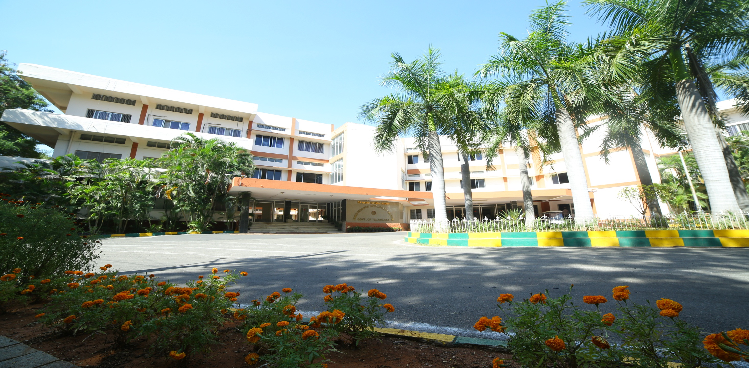
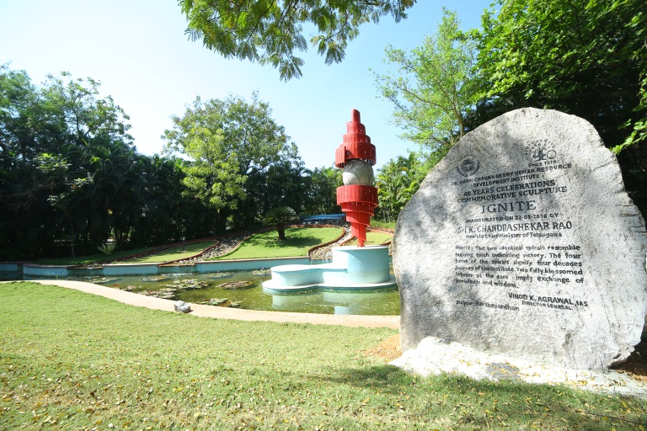
Welcome to Dr. Marri Channa Reddy Human Resource Development Institute of Telangana (MCRHRDIT)

Slide 2
About the Institute
Dr. MarriChanna Reddy Human Resource Development Institute is a government owned organization located in Hyderabad, Telangana.
The institute started as Institute of Administration in 1976. It was renamed in 1998 after former Chief Minister of united Andhra Pradesh, Dr. MarriChanna Reddy.
Catering to the training needs of both State and Central Governments, MCR HRDI been churning out trained and committed employees.
Spread over 37 acres of picturesque land, having distinguished faculty, state-of-the-art infrastructure, comfortable accommodation, and a vast array of recreational facilities, MCR HRDI is the most popular ATI in the country.

Slide 3
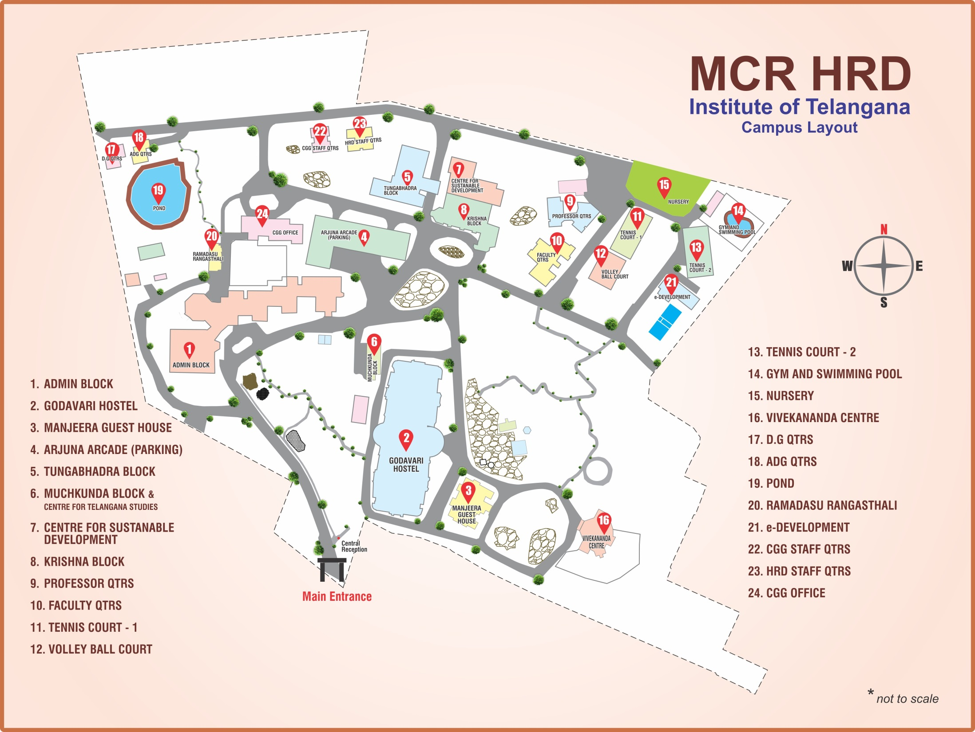

Slide 4
MCR HRDI OPERATES THROUGH VARIOUS CENTRES
Centre for Public Administration (CPA)
Centre for Financial Management (CFM)
Centre for Sustainable Developmental Goals (CSDG)
Centre for Information Technology (CIT)
Centre for Urban Development Studies (CUDS)
Centre for Telangana Studies (CTS) and
Management Development Centre (MDC)

Slide 5
Advantage Dr.MCR HRDIT
Unique advantage in view of multiplicity of CTIs and other National Institutes.
Faculty drawn from Institutions like ISB, IIIT, ASCI, University of Hyderabad, NALSAR etc.
Collaboration with National Institutes like NIRD, SVPNPA, etc.

Slide 6
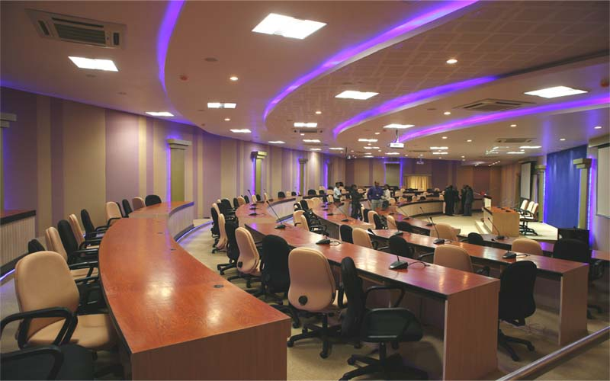
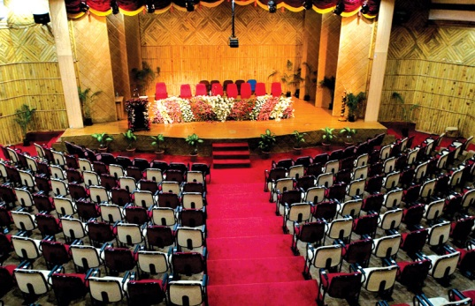
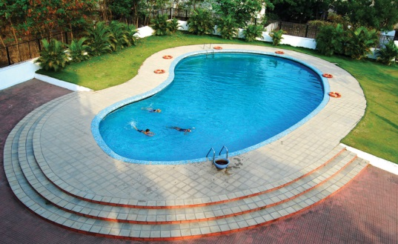
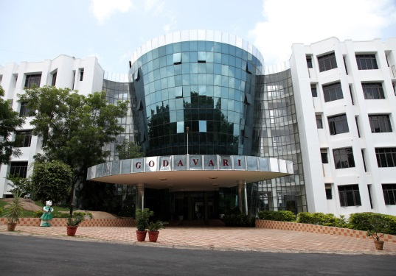
Advantage Dr. MCR HRDIT…
Well equipped classrooms 15, Auditorium, Conference halls 04
Residential facility for over 900 trainees
15 suites in guest house, 50 staff quarters
enabled campus, linked to National Knowledge Network
Video conferencing facility
Excellent sports and recreational facilities, including swimming pool

Slide 7
Facilities
Glimpses of the Institute

Slide 8
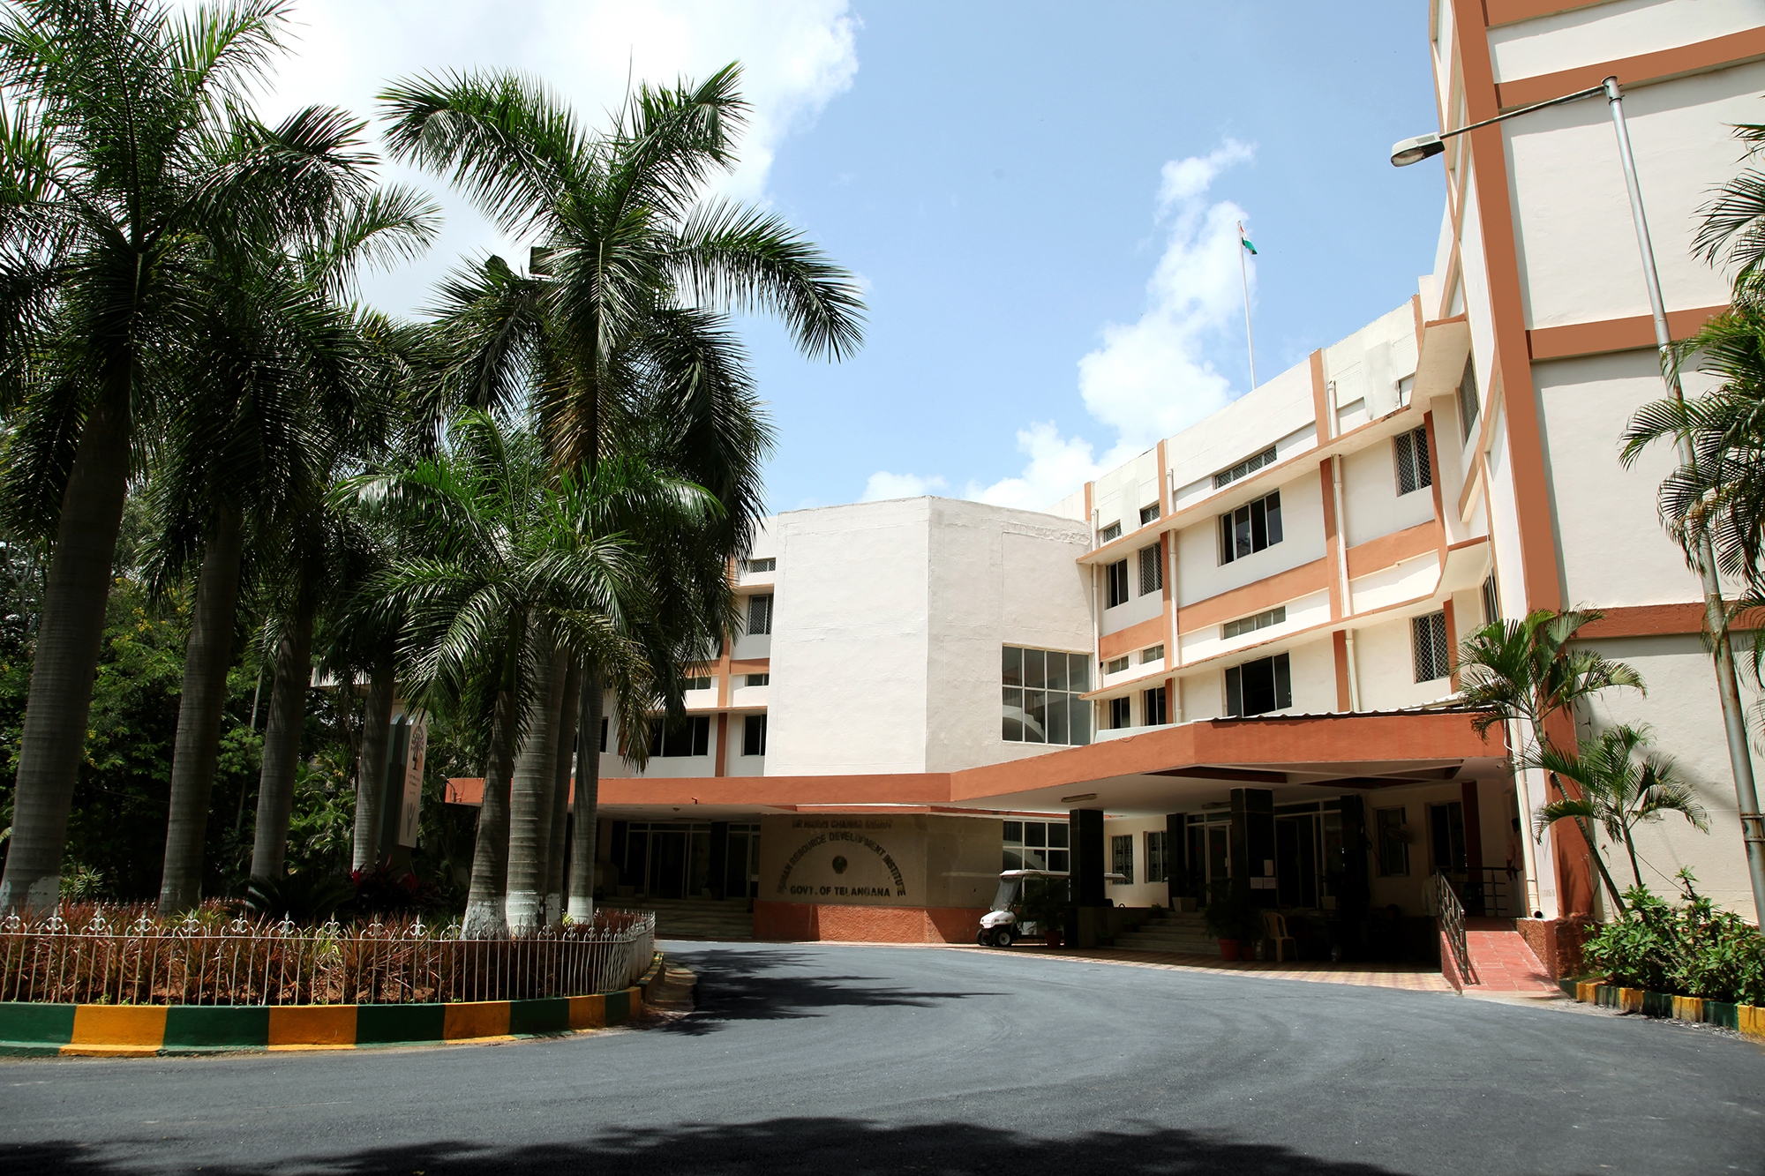
Administrative Block
Administrative Block of the Institute

Slide 9
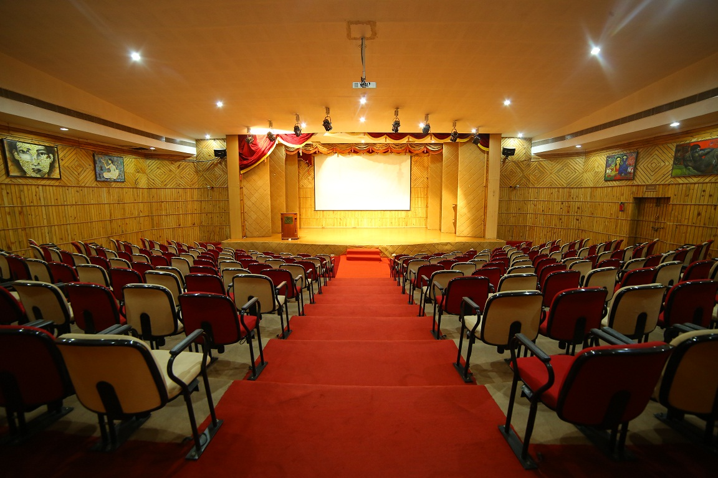
Auditorium
Dasaradhi Auditorium

Slide 10
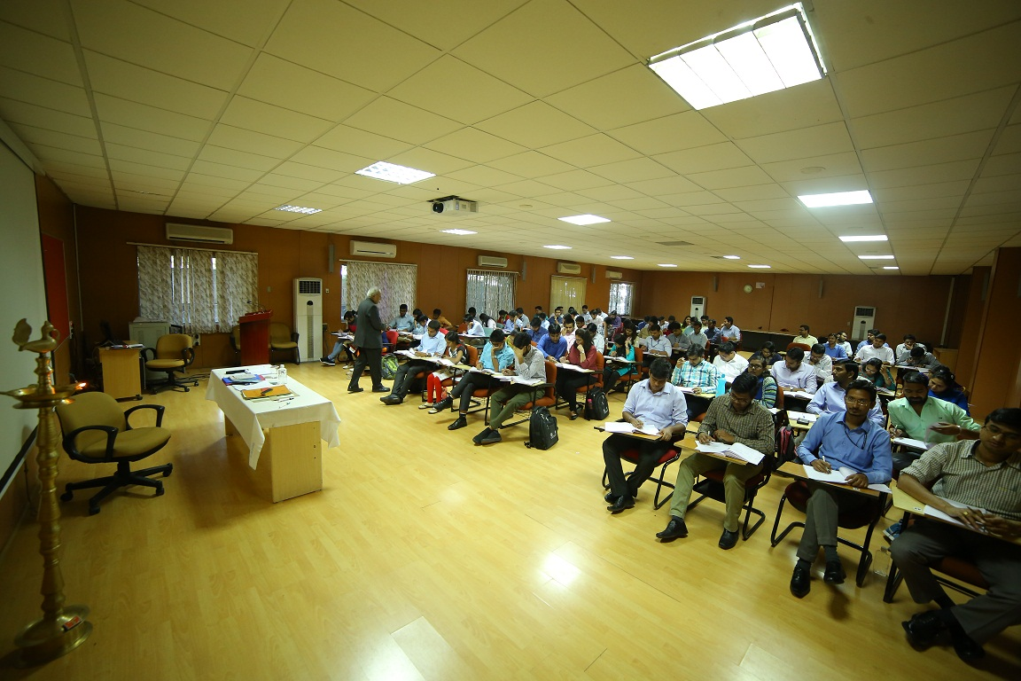
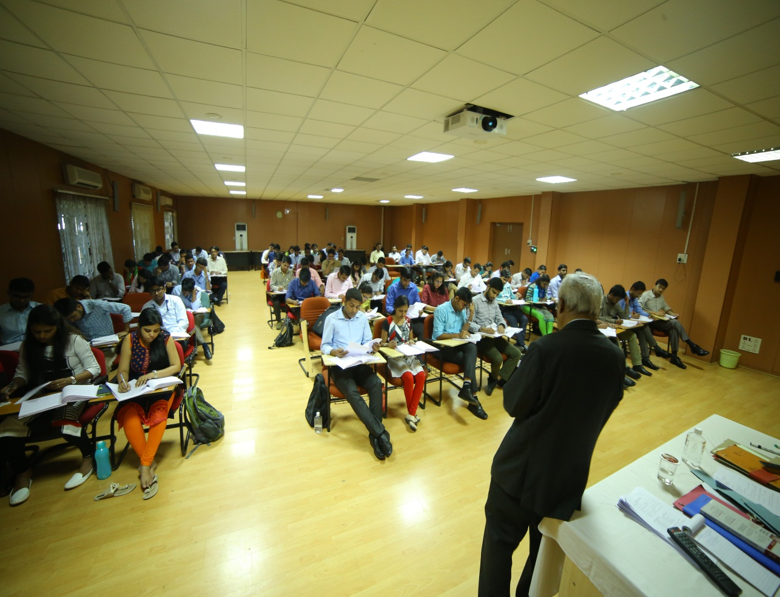
Lecture Halls
15 lecture halls with LCD Projectors, Computer, Audio System, Air Conditioned and Well Furnished.

Slide 11
Entire campus is Wi-Fi enabled.

Slide 12
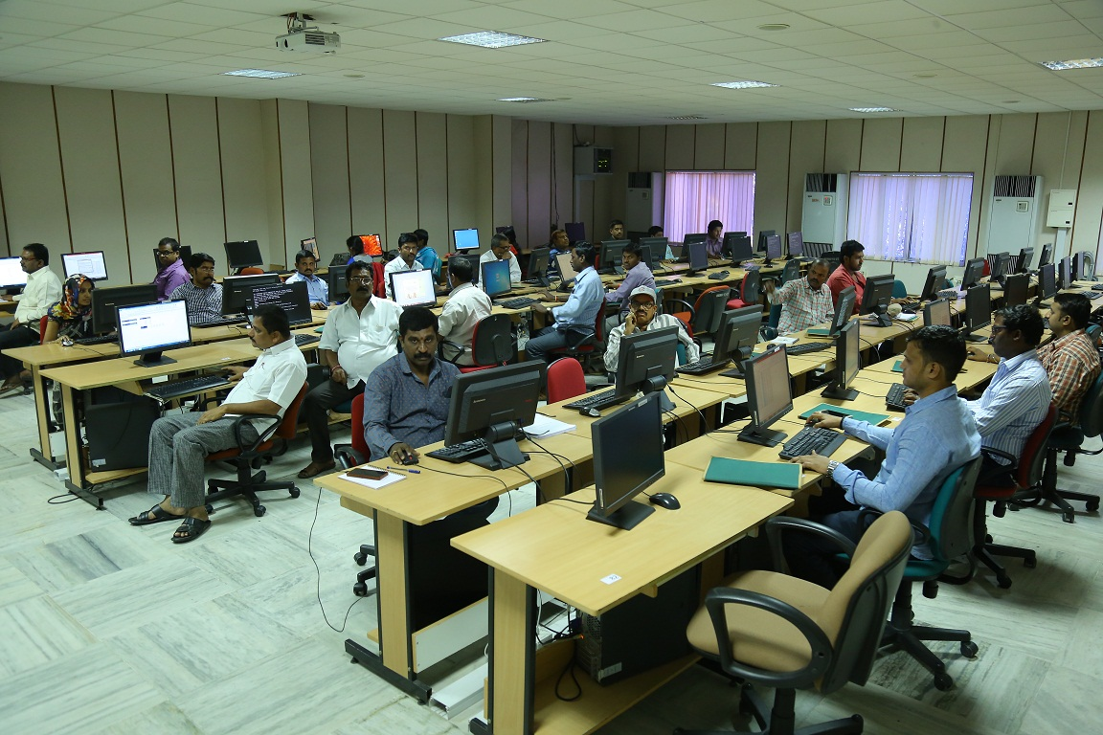
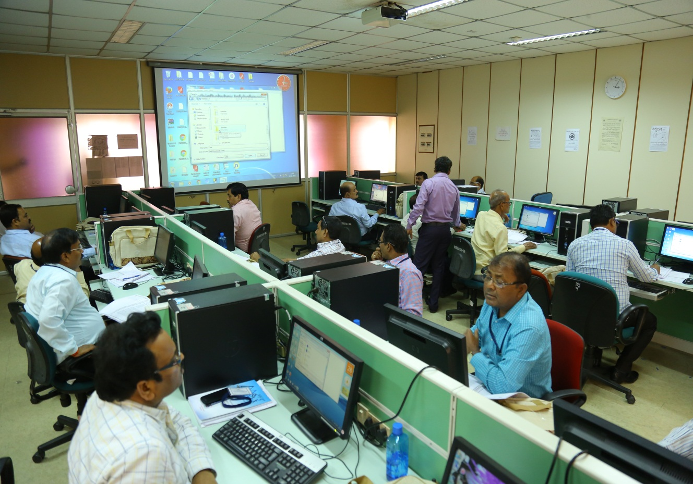
State of the Art Computer Labs
Three computer labs each with 30 desktops on LAN

Slide 13
Conference Halls

Slide 14
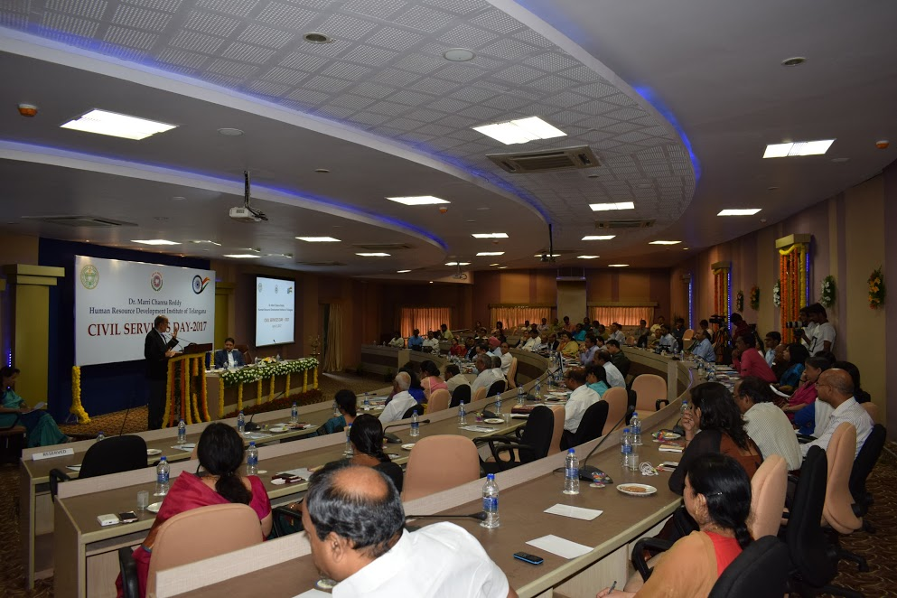
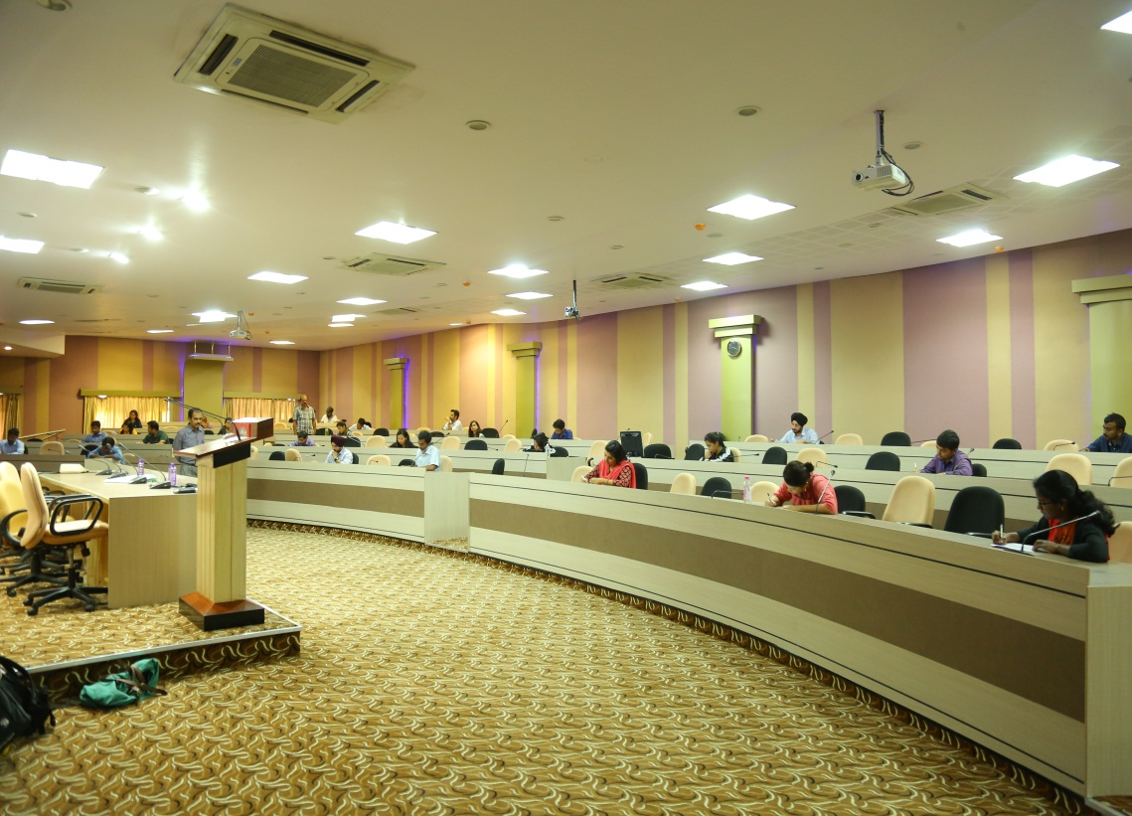
Shravana Kumar Hall
Fully Air-Conditioned -150 Seating Capacity -Dual Projection System Video Display of Dias

Slide 15
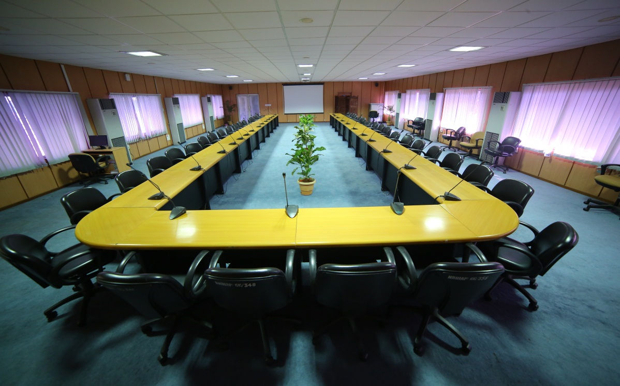
Kautilya Hall
Excellent Conference Hall -Fully Air-Conditioned -50 Seating Capacity

Slide 16
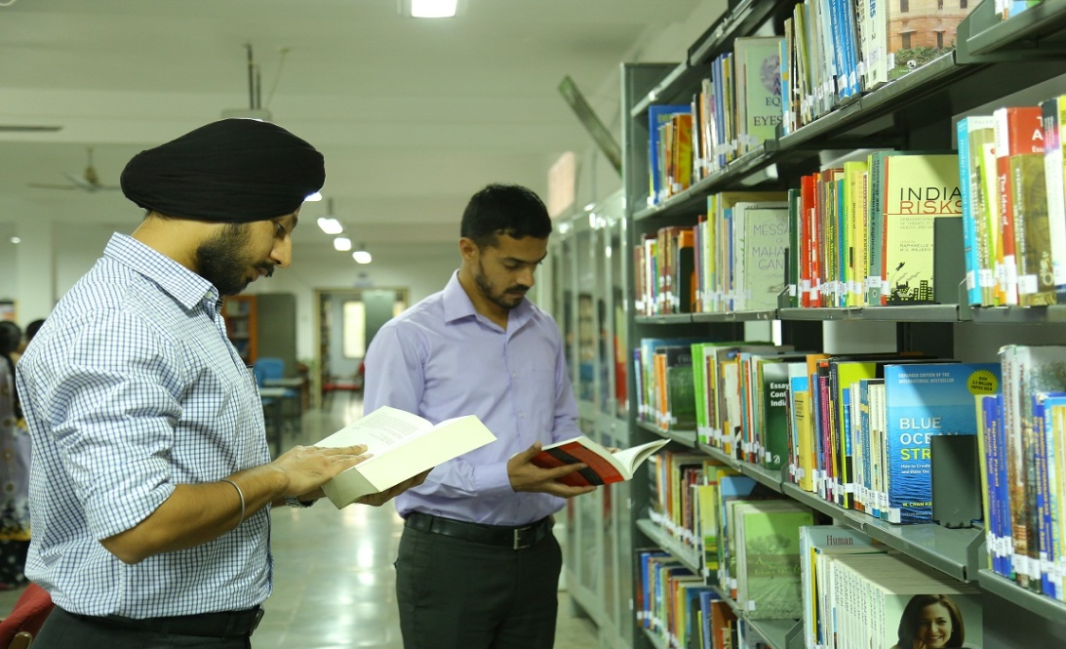
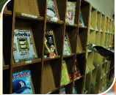
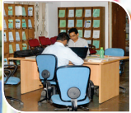
Library
Location : Cellar of Admin Block
Books: About - 10,000
Timing: 8:30 am to 10:00 pm
Subjects: Computer Science, Journalism, Science, Philosophy, Psychology, Sociology, Economics, Public Administration, Training methods/codes/manuals
(Participants can borrow books)

Slide 17
Major Lawns for open air functions

Slide 18
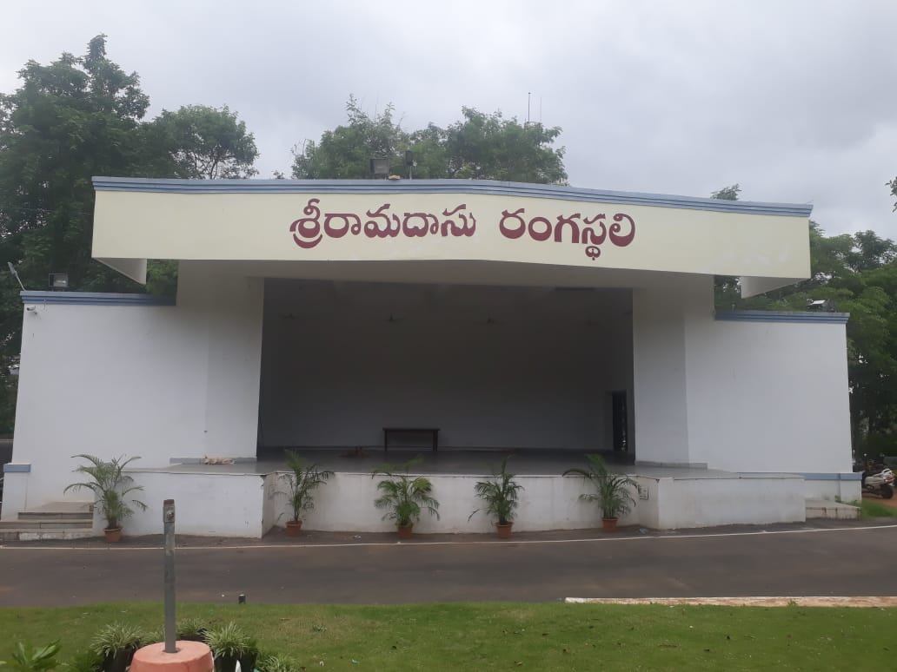
Ramadasu Rangasthali (i.e.) Admin Block

Slide 19
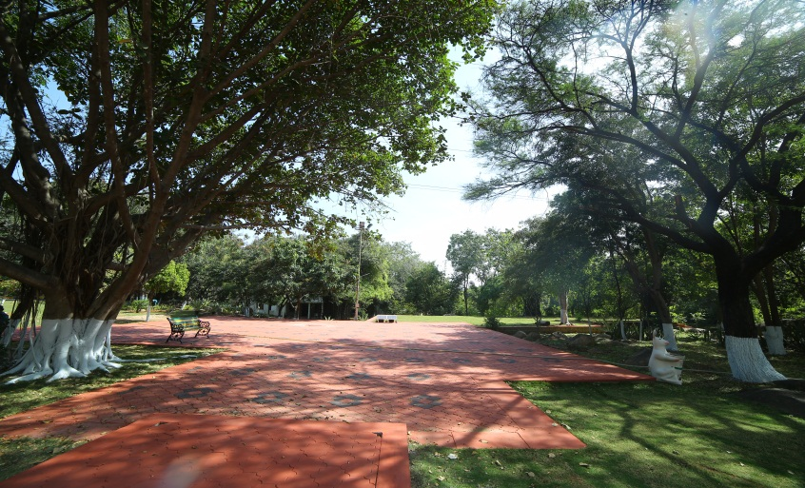
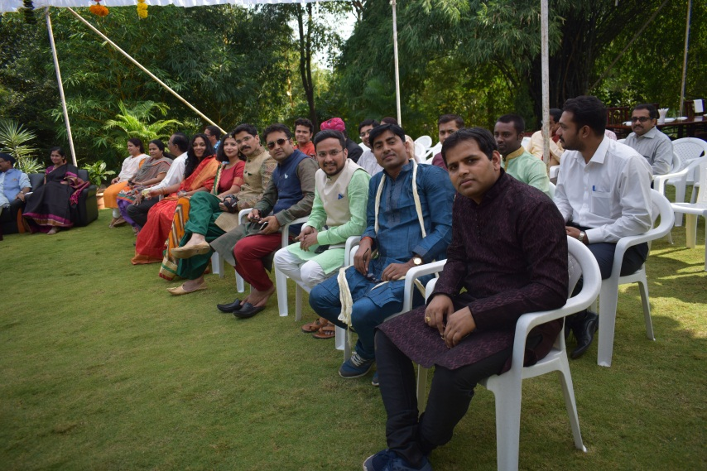
nandanavanam Lawn

Slide 20
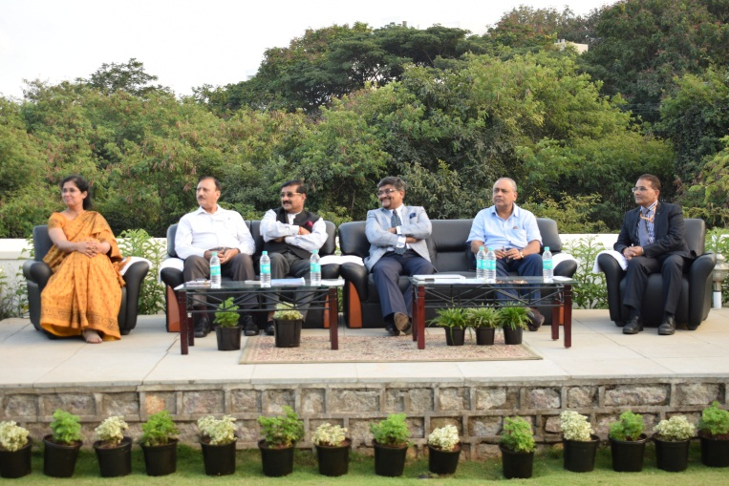
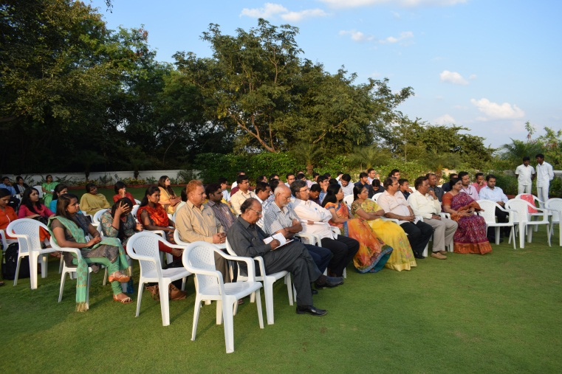
Vivekananda Lawns

Slide 21
Accommodation facilities

Slide 22
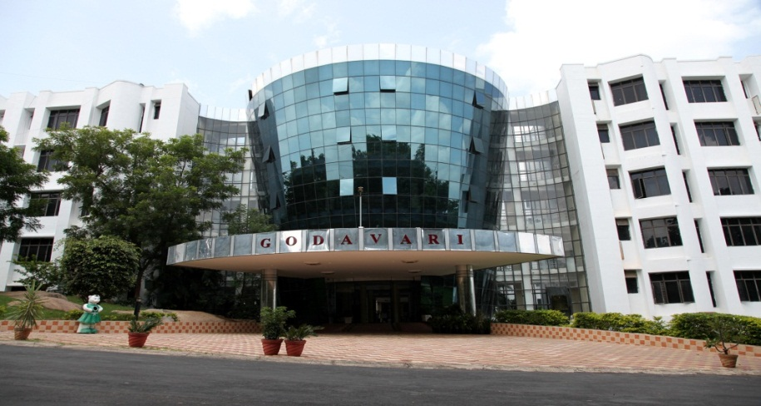
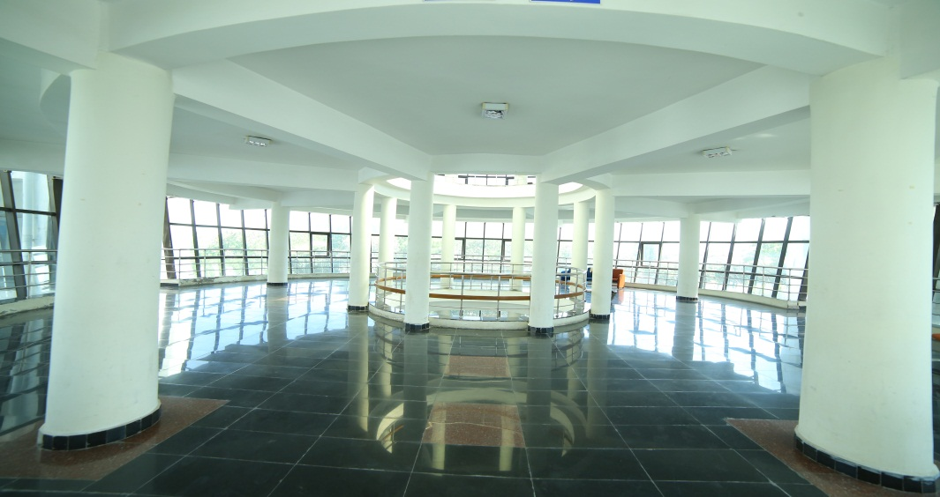
Godavari Residency
370 well appointed rooms
Centrally Air Conditioned
Computer Labs with net facility
Reading room with news papers & magazines
Facility
Dining hall in ground floor with capacity of 200

Slide 23
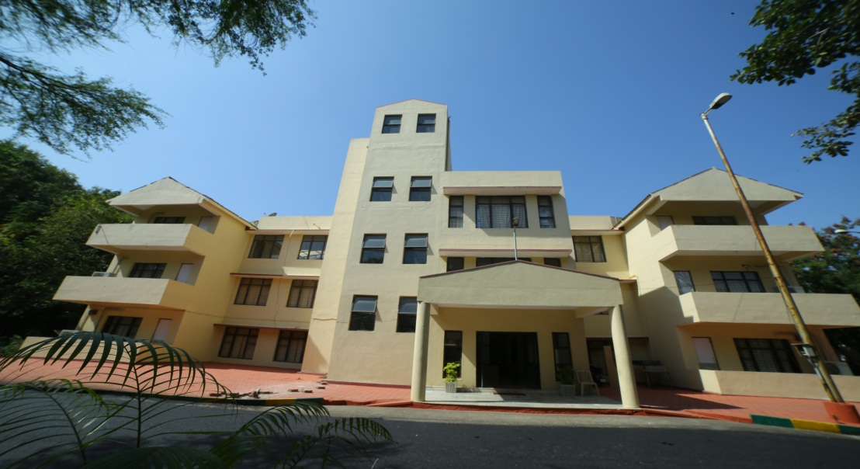
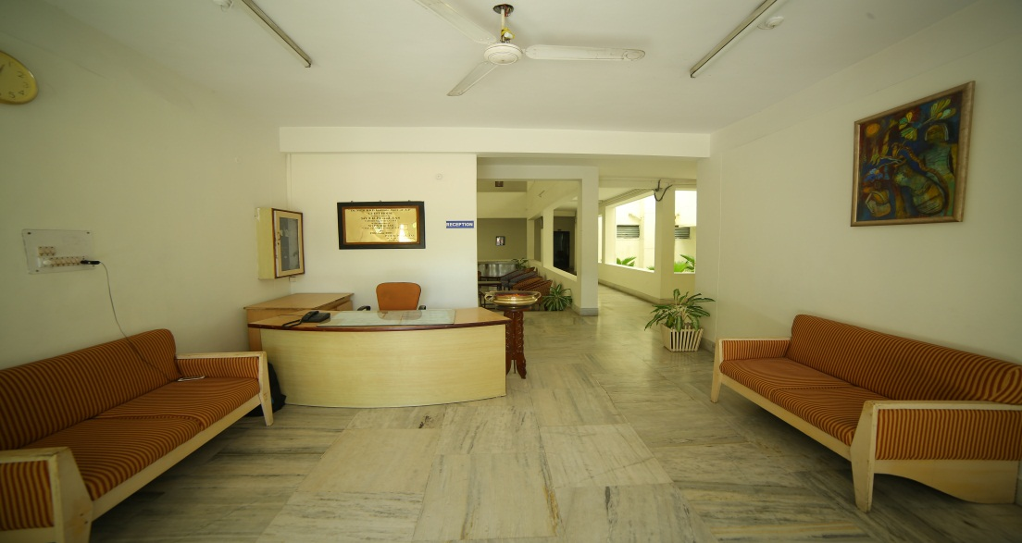
Manjeera Guest House
17 AC VVIP Suite for Secretary and above cadre officers.
Computer with internet facility.
Lobby with daily news papers and weekly magazines.

Slide 24
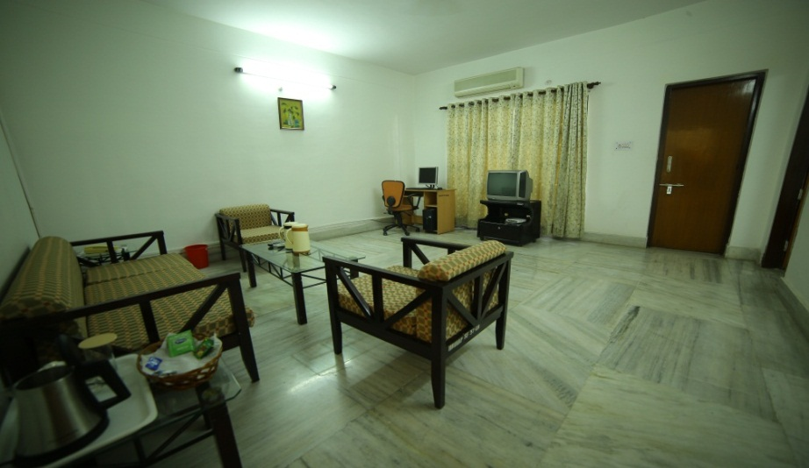
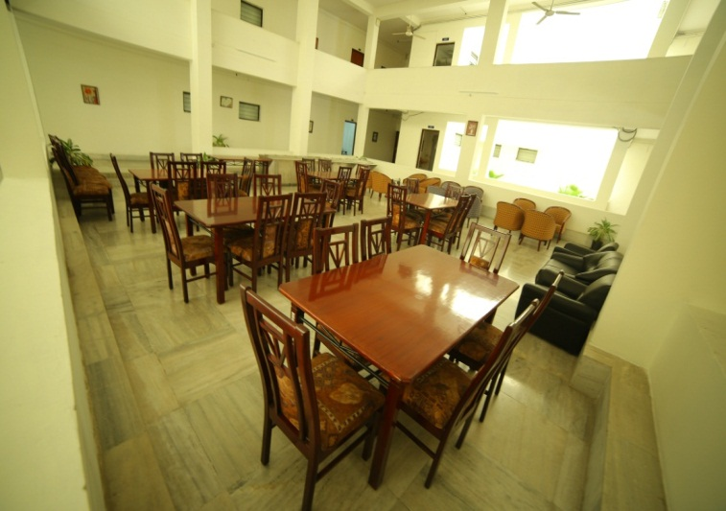
Manjeera Guest House
24/7 Hot water facility
Executive double bedroom
Wi-Fi Facility
Dining facility with capacity of 40 at 2nd Floor

Slide 25
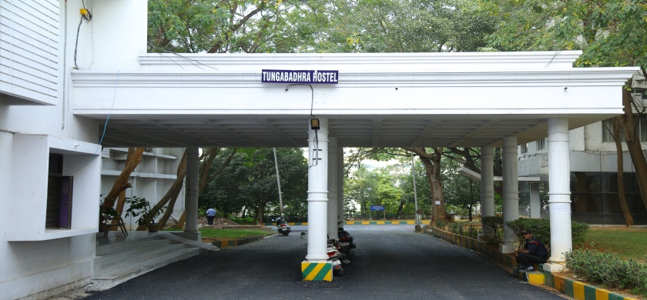
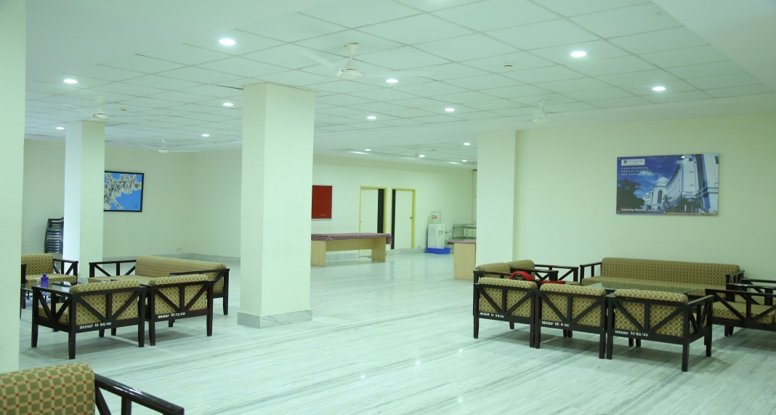
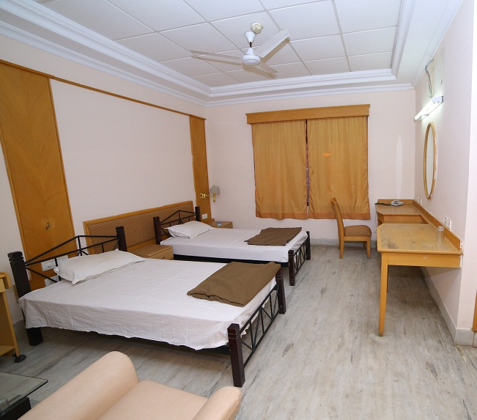
Tungabhadra Hostel
28 double bedded rooms
Pushti dining hall capacity of 150 in first floor
1 Computer Lab & a Class room
Indoor shuttle court
Trupti canteen with dining facility with capacity of 200
Hot water facility, Wi – Fi Facility

Slide 26
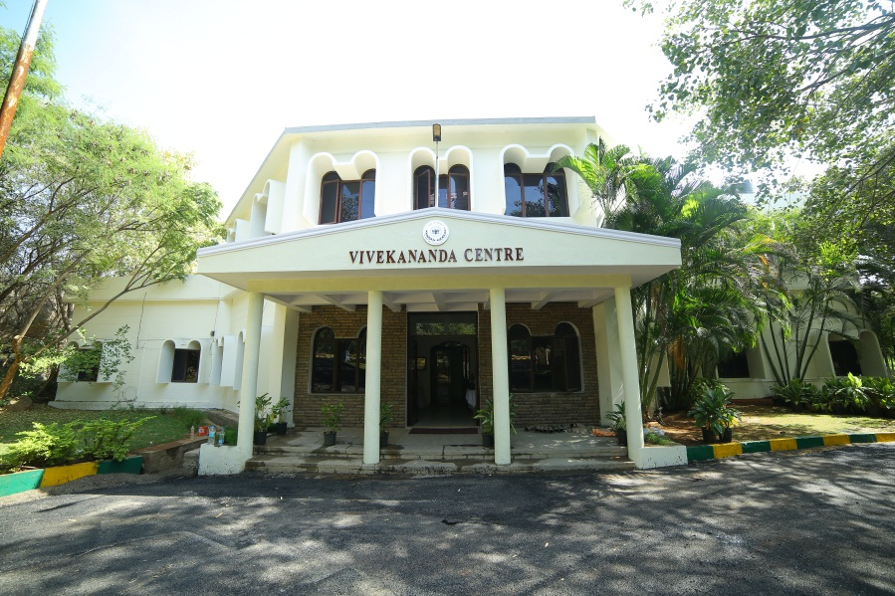
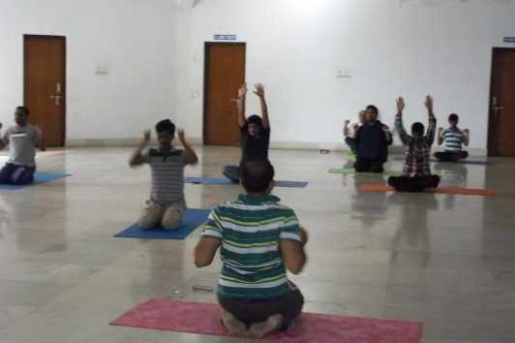
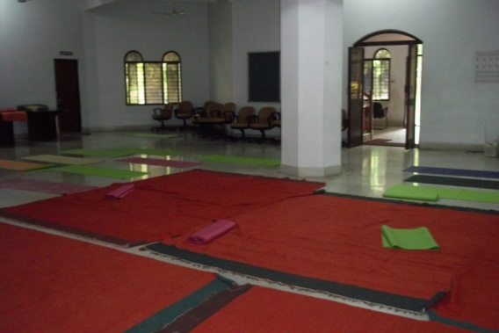
Vivekananda Centre
MENS SANA IN CORPORE SANO
(Sound mind in sound body)
Art of living on ground floor with instructors for 80 people capacity (Time: 6 Am to 8 Am)
Yoga hall on 1st floor with Yoga mats and Yoga teacher for 100 people capacity (Time:7Am - 8 Am)
Music room in ground floor.

Slide 27
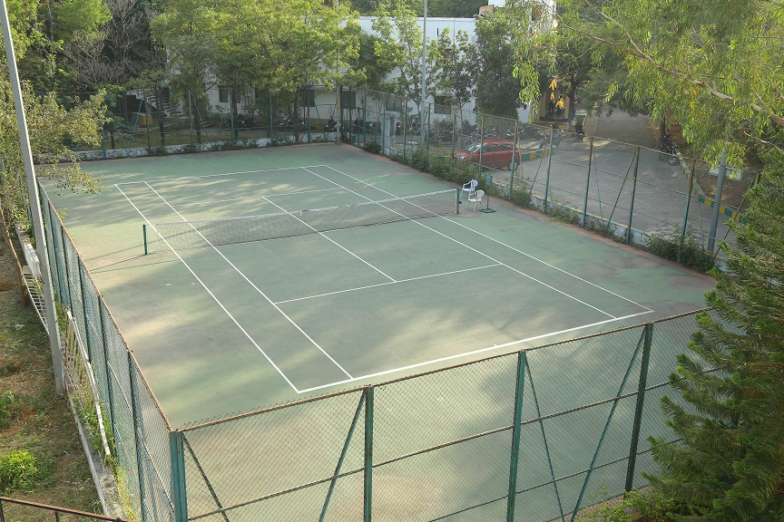
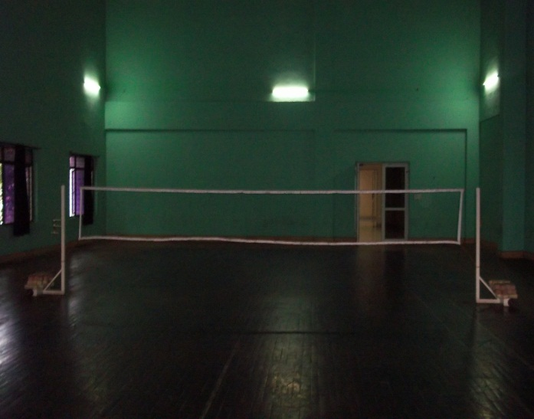
Sports
2 Tennis courts
Timing: (6:00 AM to 8:00 AM open to all)
(5:00 PM to 8:30 PM open to all)
One Indoor Wooden Badminton court at Tungabhadra 2nd floor
Timing: (6:00 AM to 9:00 AM for Ladies)
(5:00 PM to 9:00 PM for Gents)

Slide 28
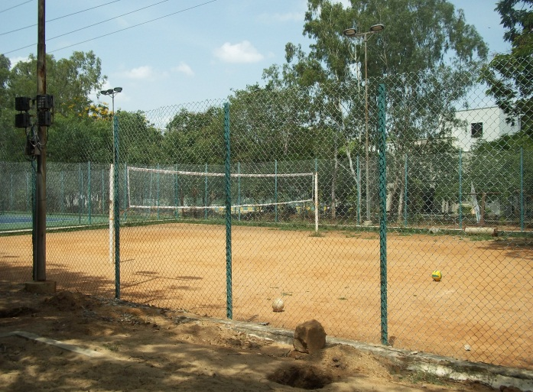
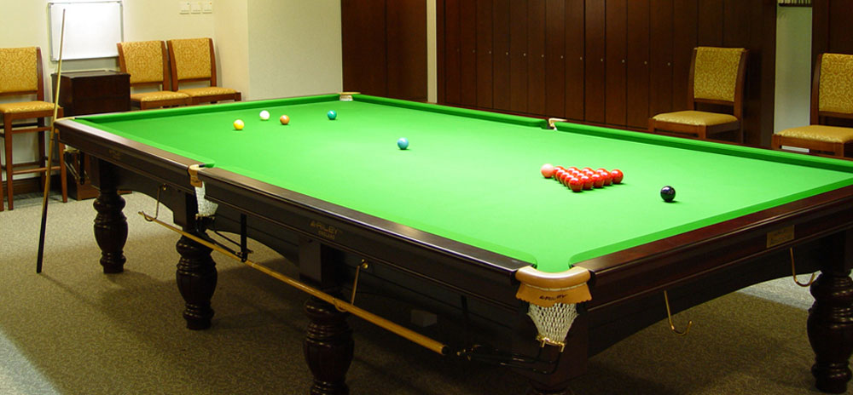
Sports...
Volley ball court
Timing: (6:00 AM to 8:00 AM open to all)
(5:00 PM to 8:30 PM open to all)
Billiards board at Godavari Residency on 3rd Floor
Timing : (6:00 AM to 8:00 AM open to all)
(5:00 PM to 8:30 PM open to all)

Slide 29
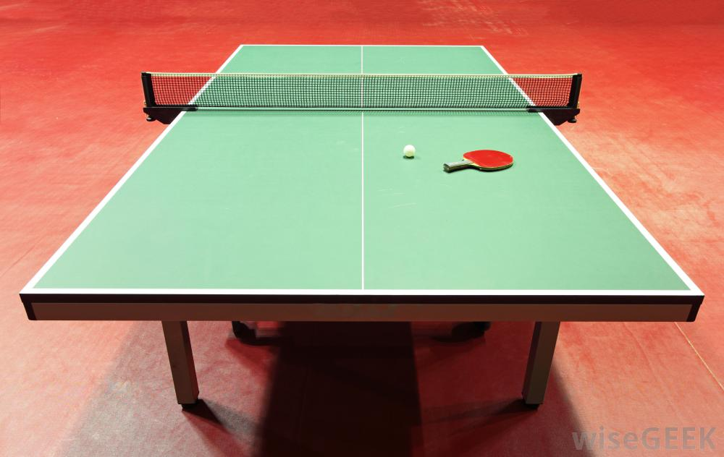
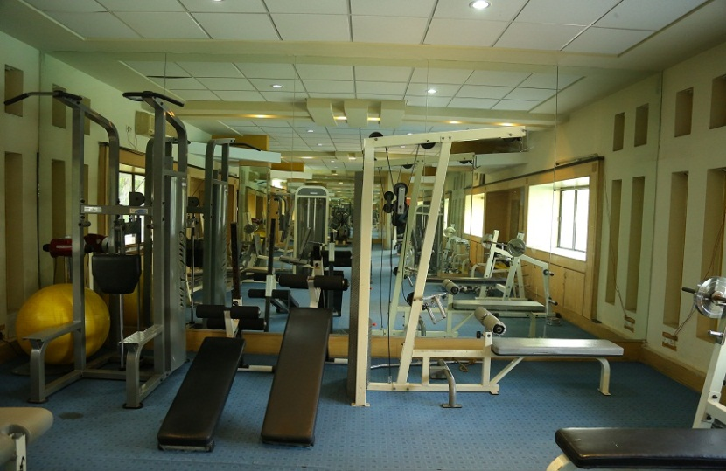
Sports...
2 Table tennis boards at Godavari Residency on 3rd Floor
Timing: (6:00 AM to 8:00 AM open to all)
(5:00 PM to 8:30 PM open to all)
Well equipped Gym with Instructor
Timing: (6:00 AM to 8:00 AM open to all)
(5:00 PM to 7:00 PM for Gents)
(7:00 PM to 8:30 PM for Ladies)
Exclusive Ladies Gym at Godavari Hostel opposite to Room No.265 and 266

Slide 30
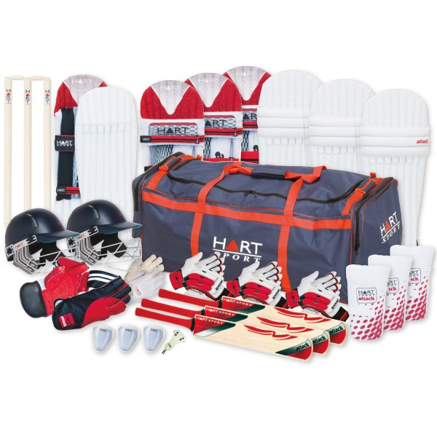
Sports...
One well maintained Swimming pool with
Swimming instructor and a lifeguard.
Timing: (6:00 AM to 8:00 AM open to all)
(5:00 PM to 7:00 PM for Gents)
(7:00 PM to 8:30 PM for Ladies)
Cricket kit is available.

Slide 31
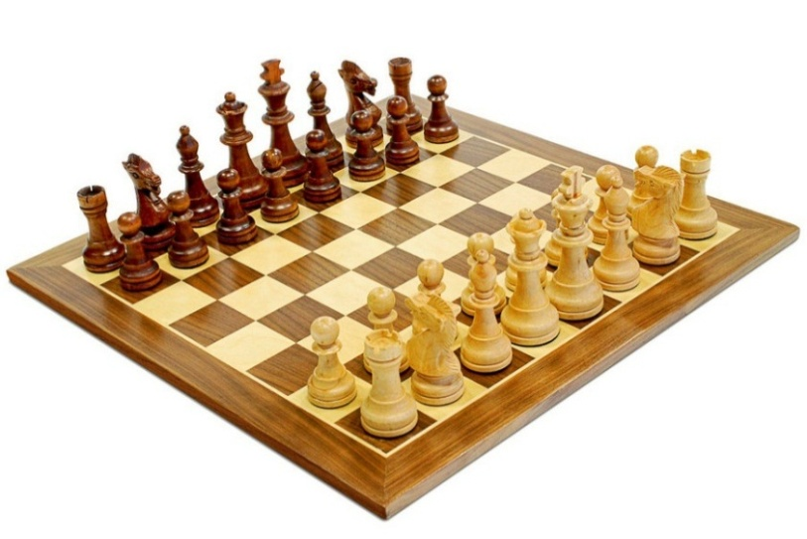
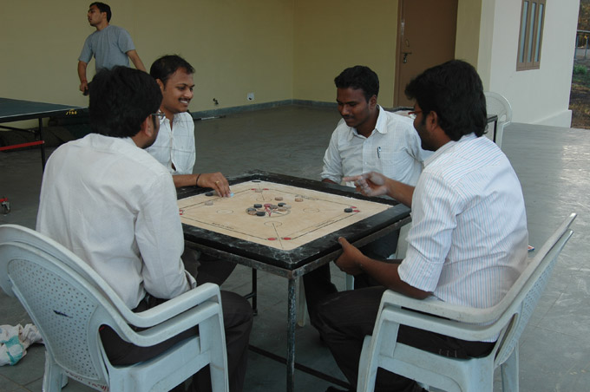
Sports...
Chess
Caroms and Chess boards available at Godavari Reception

Slide 32
Canteen & Dining

Slide 33
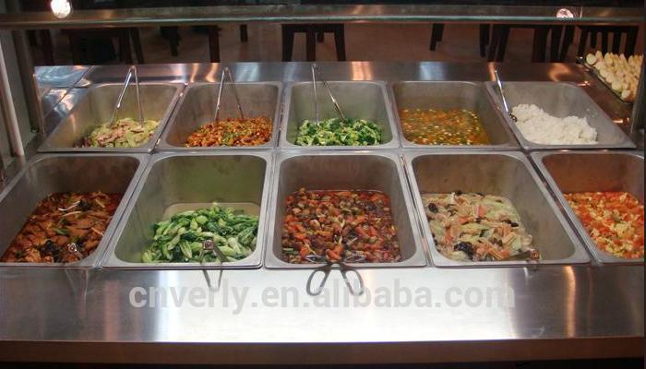
Canteen & Dining
Timing :
Bed tea at 6:00am
Breakfast from 8:15 am to 9:30am
Lunch from 1:15 pm to 2:30pm
Dinner from 8:15 pm to 9:30pm
Please Note:
Food not allowed in the rooms
Give your feedback on food. Feedback Book is available in the dining hall

Slide 34
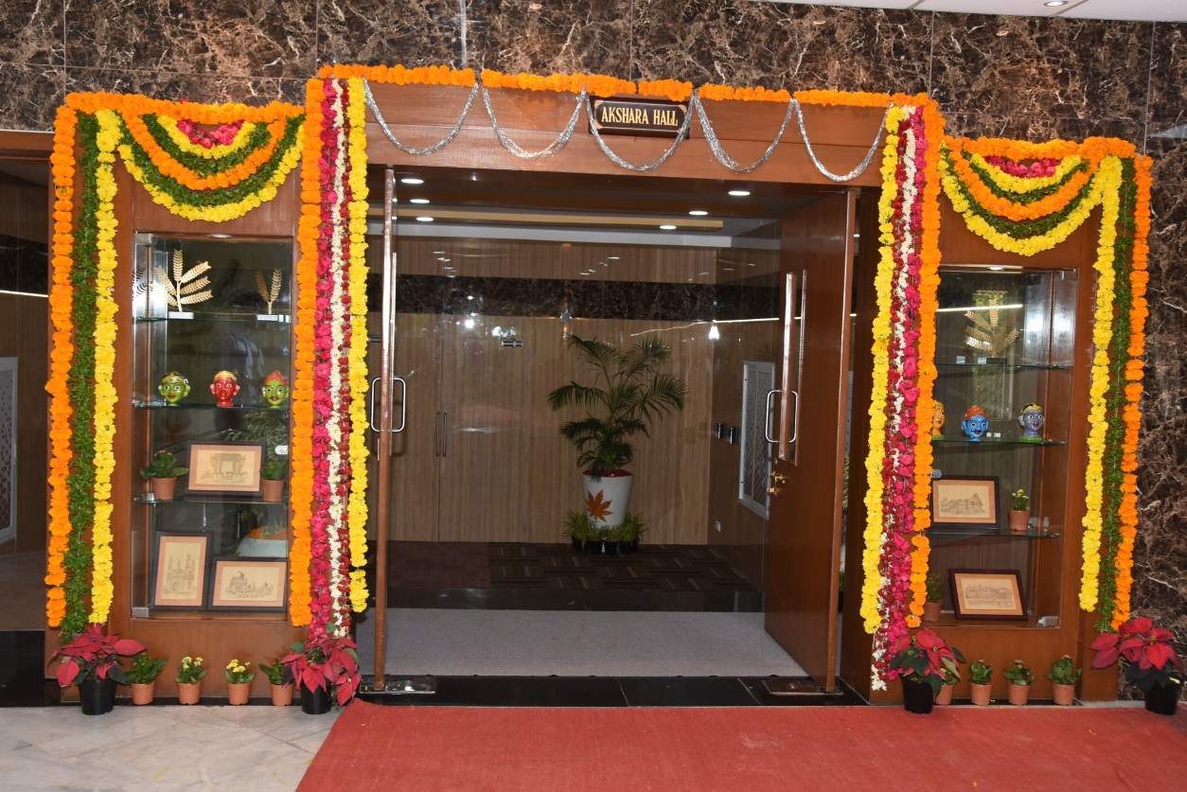
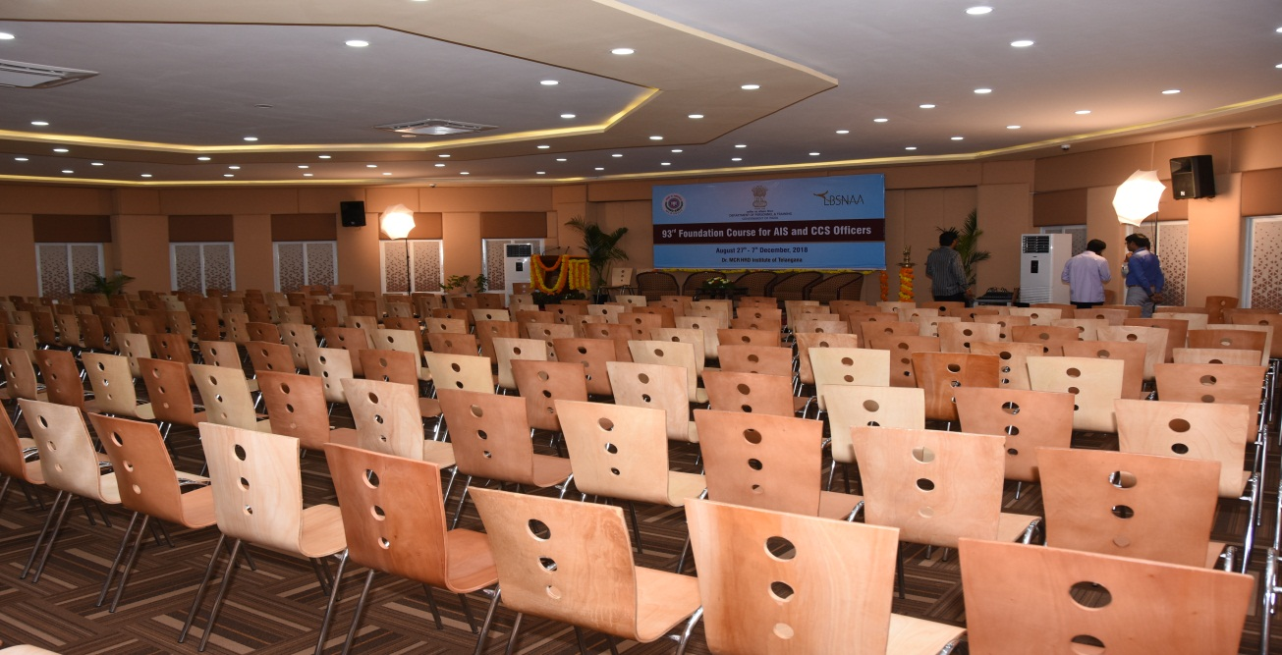
Akshara hall (Multipurpose)
360 capacity.

Slide 35
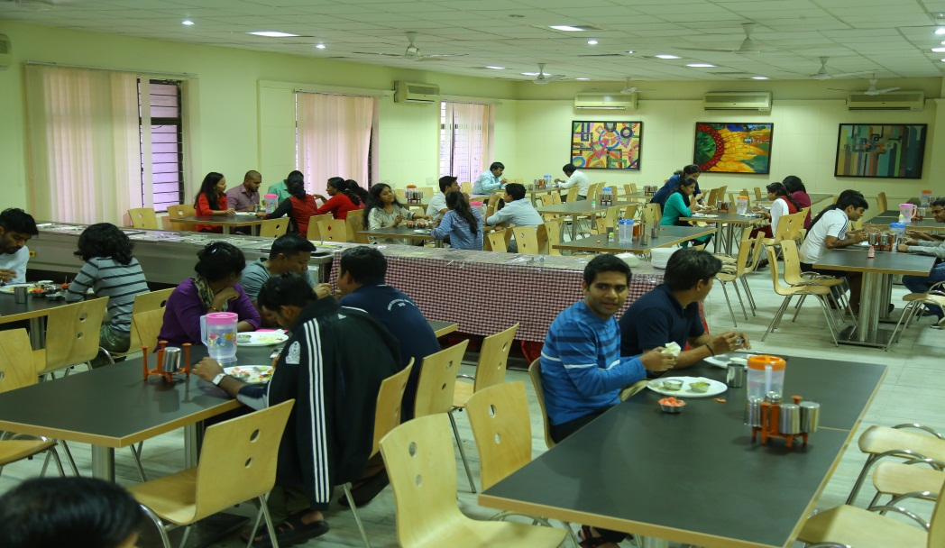
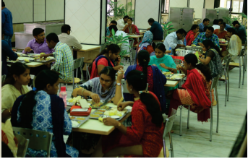
Tungabhadra :
Pushti canteen with 150 seating capacity
Trupthi canteen with 200 seating capacity

Slide 36
Godavari : Ruchi
Ruchi Canteen with 200 seating capacity

Slide 37
Medical Dispensary
Doctor is available in Room No 266 second floor
Dispensary operates from 7 am to 8 pm
In case of emergency candidates taken to near by hospital.
Emergency vehicle available -
contact reception for further assistance

Slide 38
Public Amenities
Vijaya dairy
ATM
Chai Kahani

Slide 39
Quarters
Professor Quarters
12 (3 bed room)
Faculty Quarters
12 (2bed room)
Staff Quarters
24 rooms

Slide 40
Helipad
Helipad near DG & ADG quarters

Slide 41
Transport
Swaraj Mazda mini bus: Capacity of 20 seats
Each with capacity 11 for Physically challenged participants
Shuttle service available for pick and drop from Dr. MCR HRDI to Jubilee Hills Check Post and back

Slide 42
Laundry Facilities
Room No G5 at Godavari
Six Front loaded Washing Machines.
Two top loaded washing machines.
Laundry collection & delivery on payment basis and laundry persons will be available at Godavari residency near reception from 8:00 AM to 10:00 AM
Contact No 9063703296

Slide 43
Vehicle Parking
Three stored building parking at Arjuna Arcade, capacity of 200 four wheelers
Two wheeler parking behind Admin block

Slide 44
Barber Shop
Godavari Hostel, Room No. C 35
Timings: 07:00am to 09:00am (Morning)
05:30pm to 09:00pm (Evening)

Slide 45
Contact Details
Name | Designation | Contact Number
Smt. J.V.S.Lakshmi | Manager (Facilities) | 9490189761
Sri Mahesh | Facilities Executive | 8106966617
Sri Nagaraj | Facilities Executive | 9677757539
Sri Srinivas | Sports In charge | 9705539957
Please provide feedback regarding facilities & catering to facilitiesfeedback@mcrhrdi.gov.in

